Slide 1

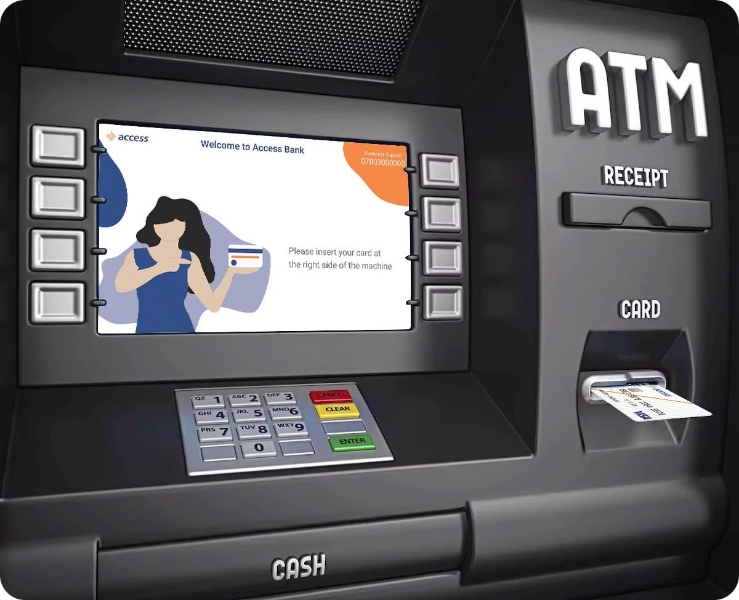
ATM Simulation Project
Welcome to the ATM Simulation Project presentation. This Python program simulates basic ATM operations, providing users with a realistic banking experience. Developed by Us for Python's Programming and Data Structure Course, this project demonstrates essential programming concepts and practical application development.

Slide 2


Project Overview
1
Purpose
2
Features
To create a simple ATM simulation that enables users to perform essential banking operations.
Check Balance, Withdraw Money, Deposit Money, Change PIN
3
Objective
Build a user-friendly program using Python that simulates real-world ATM functionalities.

Slide 3



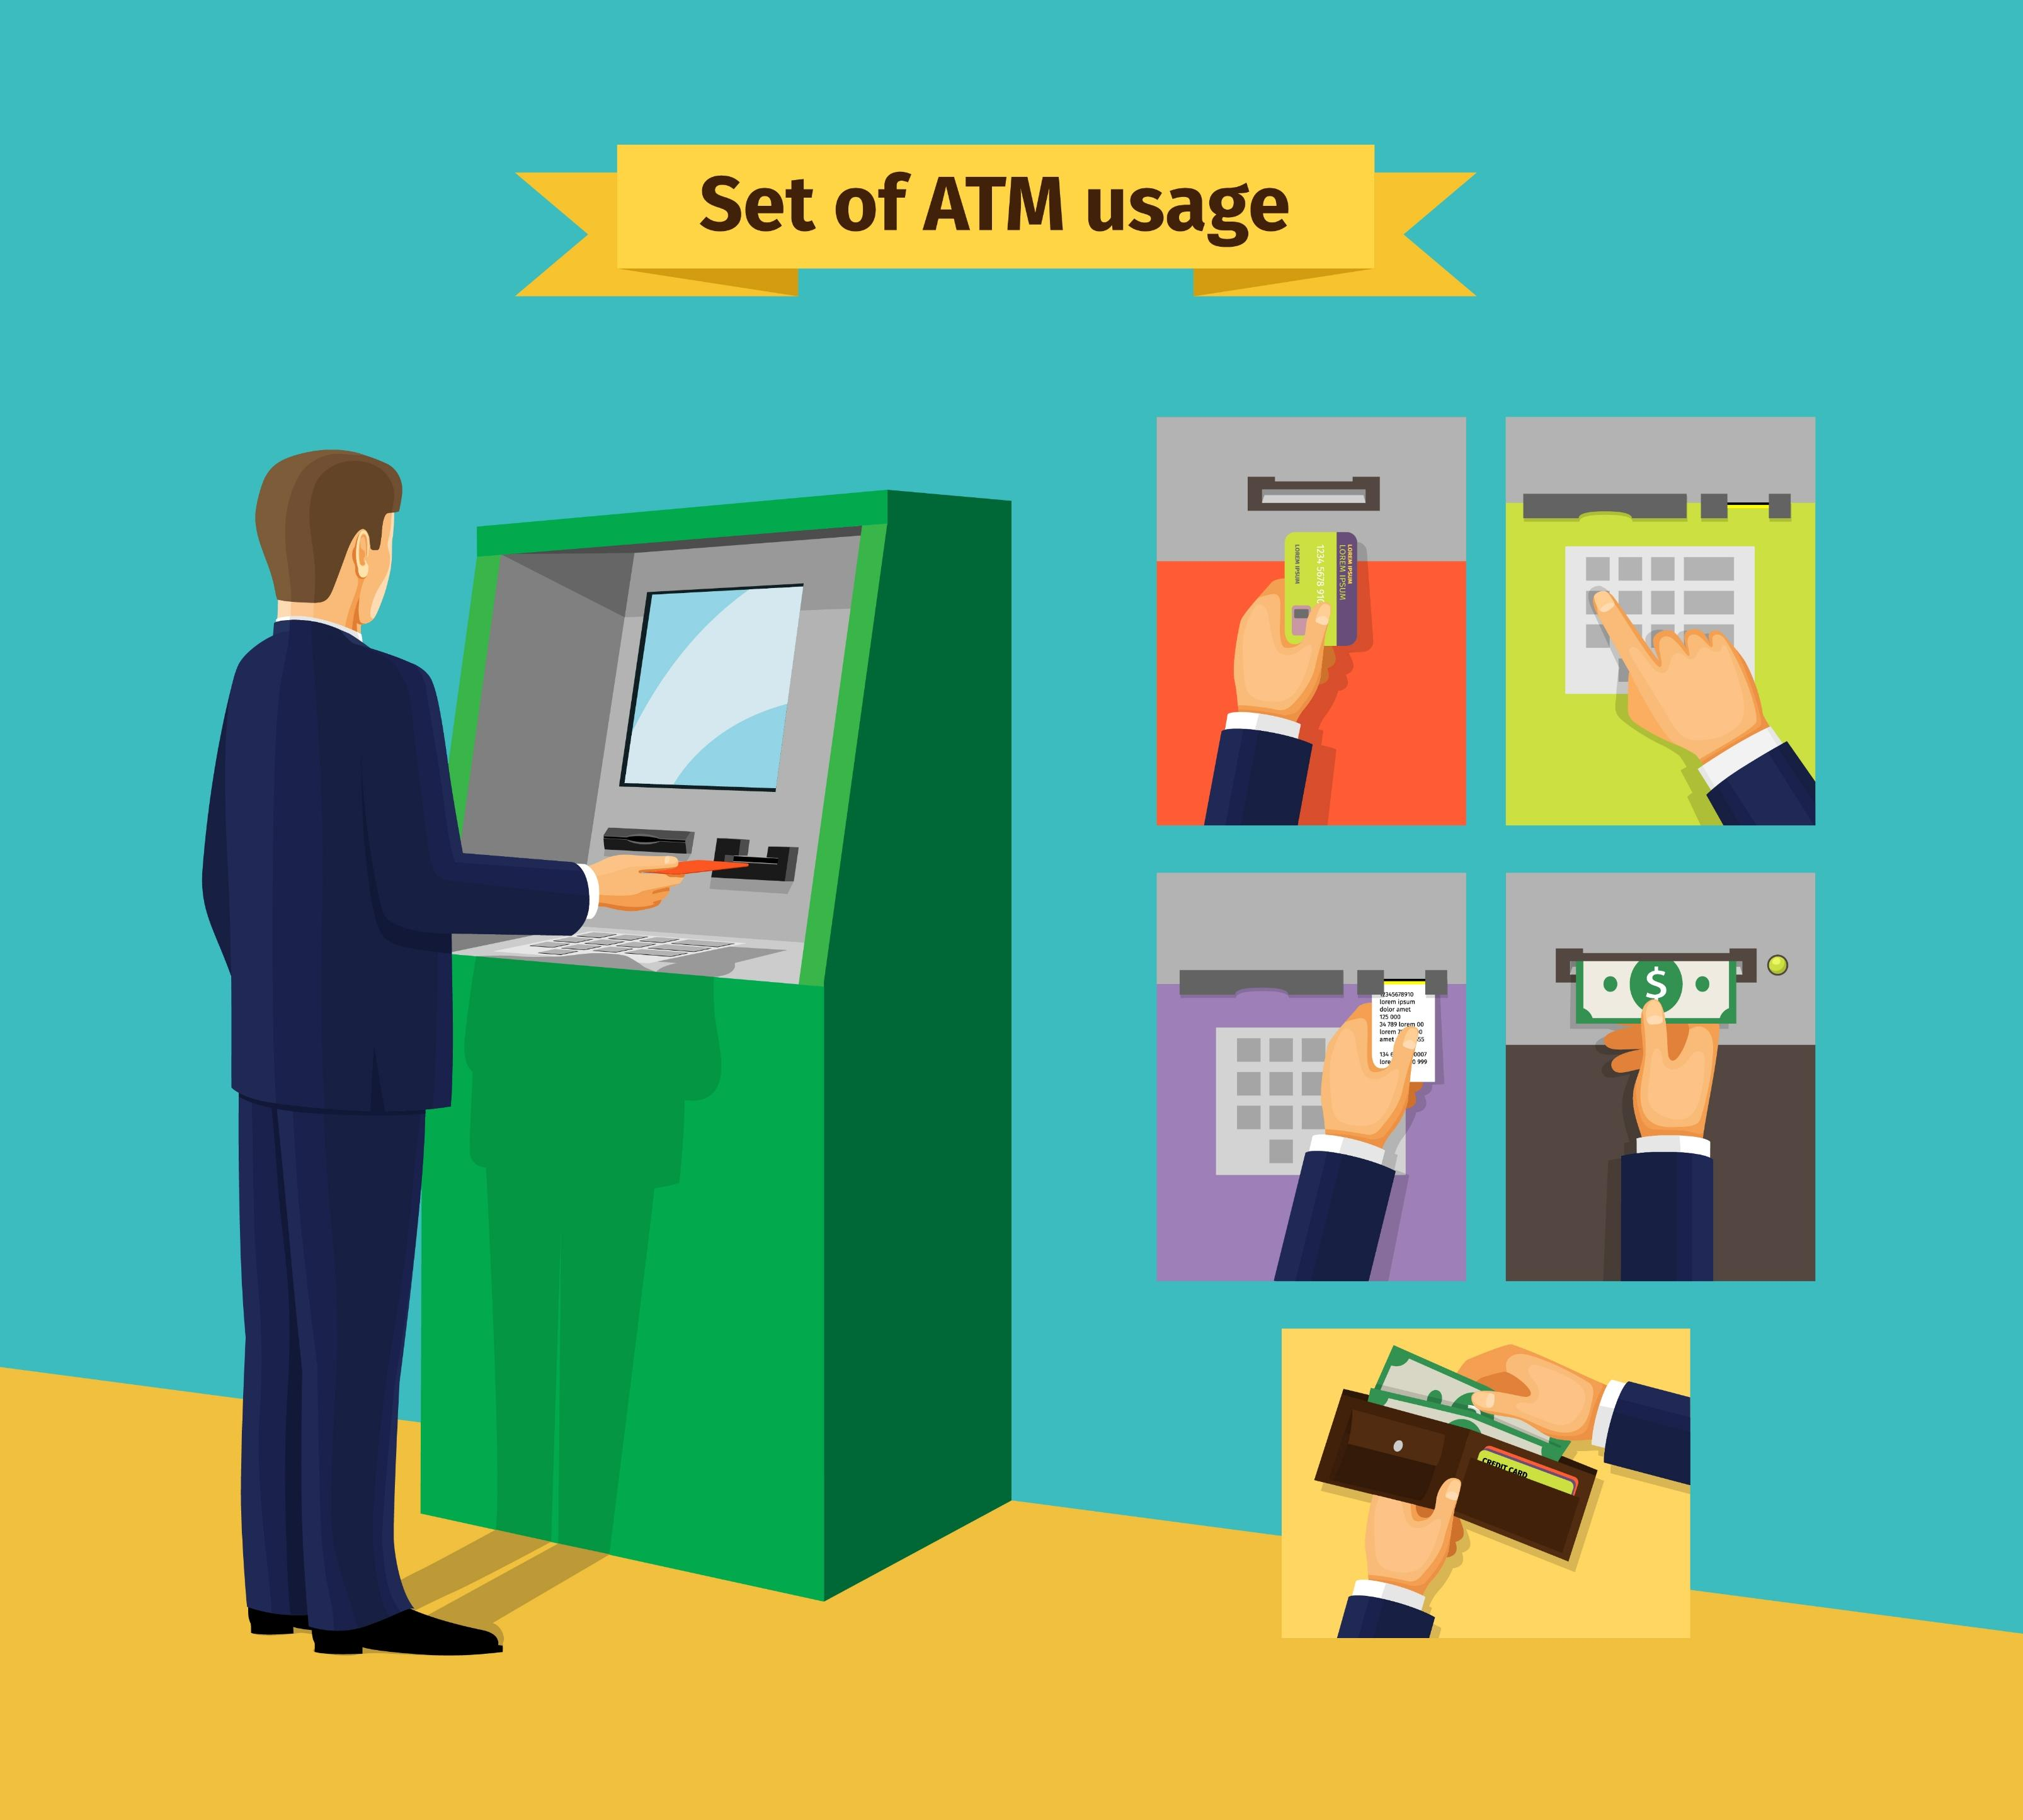

Features and Functionalities
Check Balance
Withdraw Money
View the current account balance.
Deduct funds if the account has enough balance.
Deposit Money
Change PIN
Add funds to the current balance.
Update the PIN after verifying the existing one.

Slide 4

Project Structure
1
ATM Class
Handles all core functionalities.
2
Main Function (atm_menu)
Provides a user interface with a menu for selecting different operations.
3
Code Flow
Initialize ATM with default balance and PIN. Loop through menu options until the user exits. Perform requested operation and return to the menu.

Slide 5
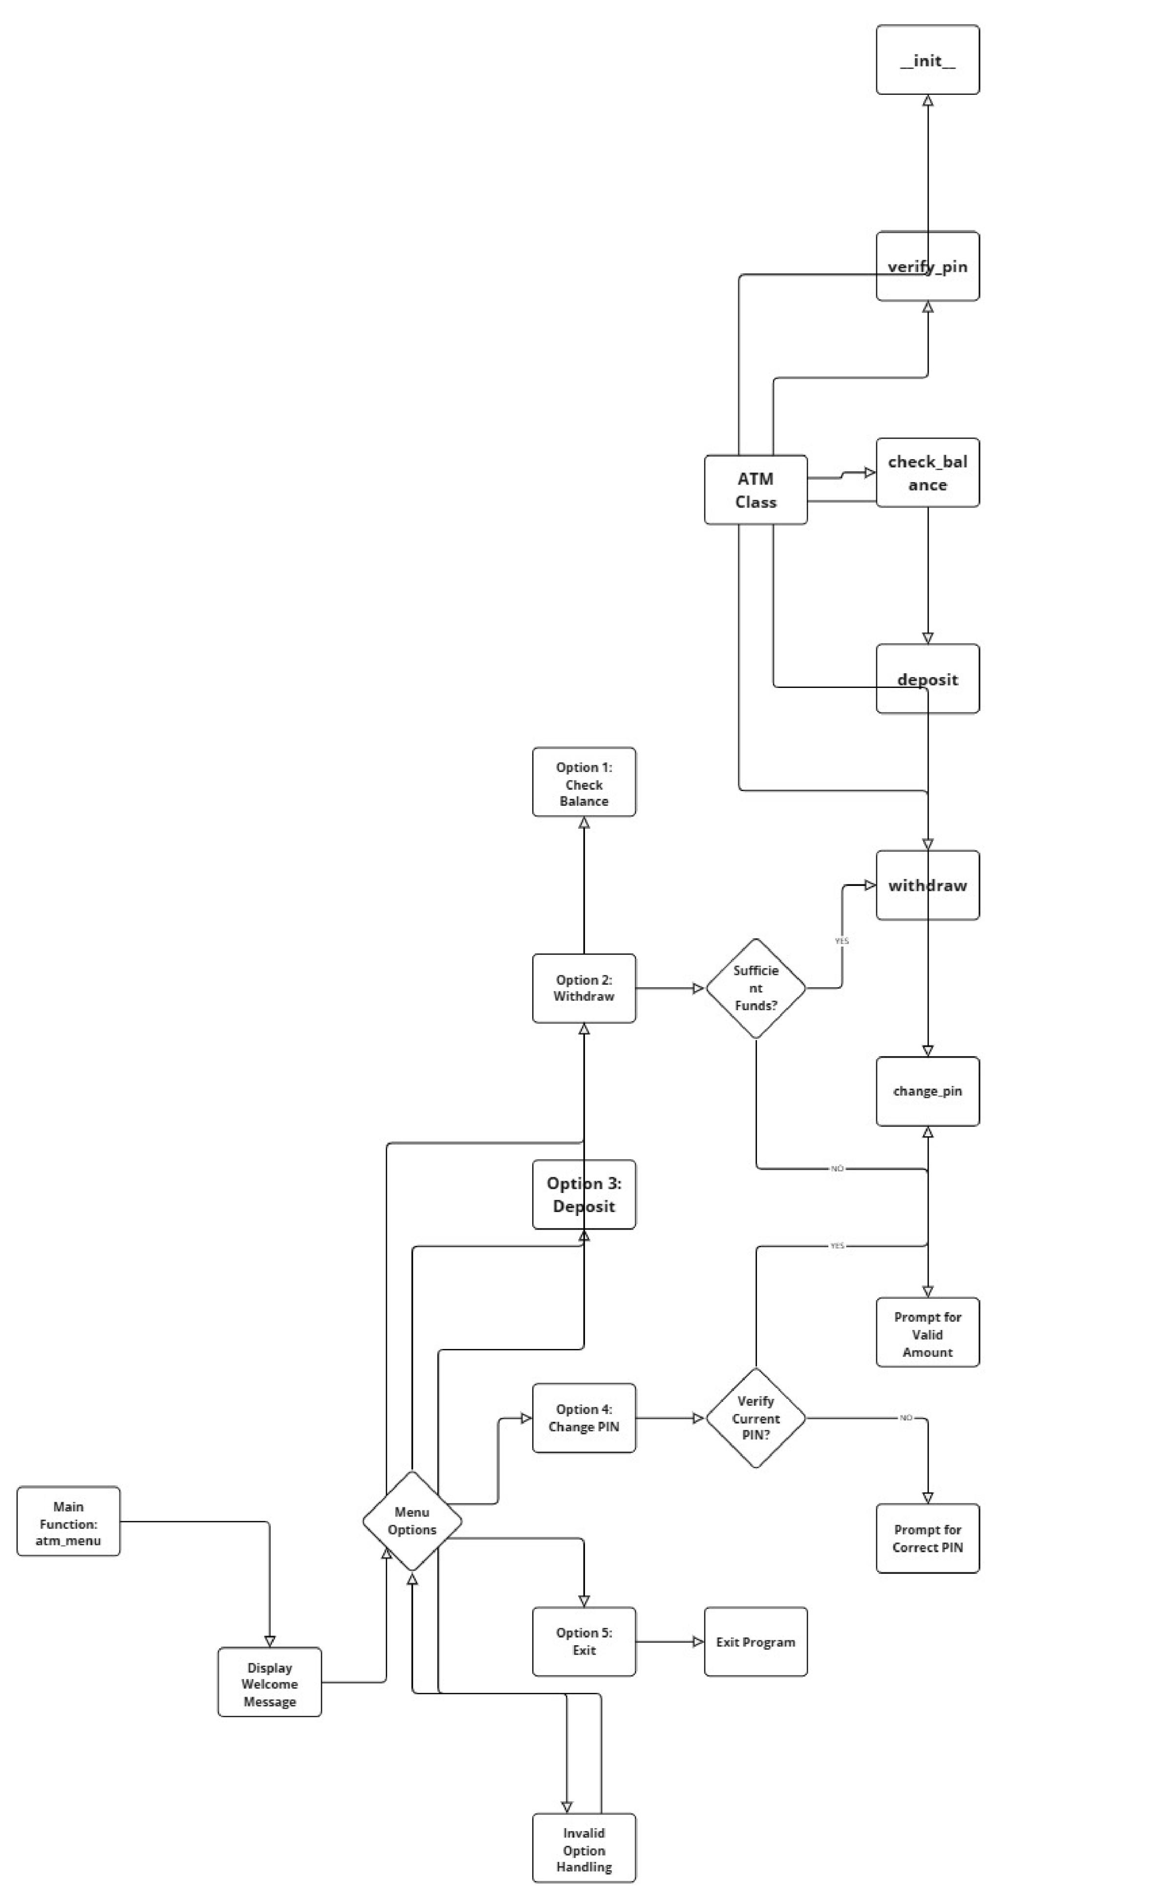

Slide 6
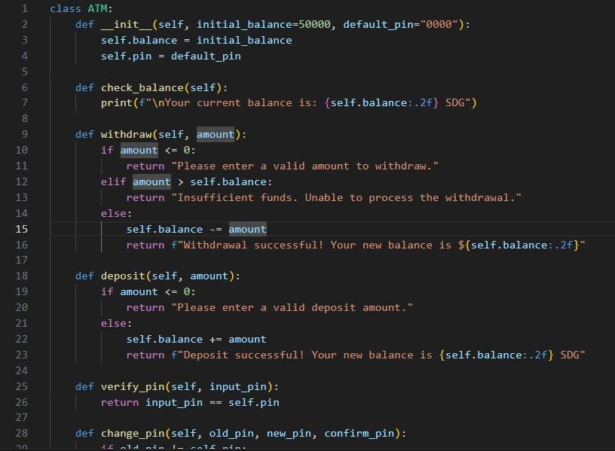
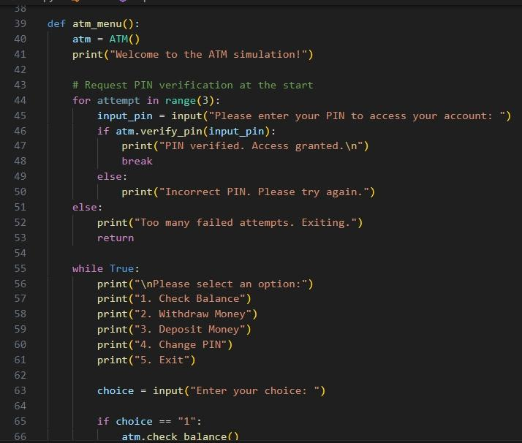
Code Example (with Screenshots)
Screenshot 1
Screenshot 2
ATM class and method definitions (e.g., check_balance, withdraw, etc.).
Main menu loop (atm_menu) showing how the program handles user inputs.

Slide 7
Testing
Tested Functionalities
Example Test Cases
Balance check returns the current balance accurately.
Withdraw more than the balance (expect error).
Withdraw and deposit operations update the balance correctly.
Deposit a negative amount (expect error).
Verify PIN change with incorrect PIN (expect error).
PIN verification before any change.

Slide 8




Usage Instructions
Launch the Program
Run atm.py from the terminal.
Menu Options
Enter the corresponding number to: Check Balance (1), Withdraw Money (2), Deposit Money (3), Change PIN (4), Exit (5)
Sample Interaction
Demonstrate a sequence where the user checks their balance, makes a deposit, and changes their PIN.

Slide 9

Documentation Overview
Code Documentation
README File
Purpose
Inline comments in each function and method.
Project Overview and Setup Instructions, Usage Instructions, Example Outputs
To ensure the code is easy to understand, modify, and test.

Slide 10


Challenges and Solutions
Challenges
Solutions
Handling incorrect inputs.
Added input validation for non-numeric and negative values.
Ensuring correct PIN verification and balance updates.
Tested with various inputs to ensure accuracy.
Provided clear messages to guide the user through errors.

Slide 11


Future Improvements
1
Planned Enhancements
2
Improved Authentication
Multi-user functionality.
Improved authentication system.
3
Additional Features
4
Goal
Additional banking options (e.g., transfer funds).
Make the simulation more realistic and versatile for potential real-world applications.

Slide 12

Prepared By
Eyad Ayoub
Mozan Elzain
Dalia Abdelrahman
Emad Siddig
Sabry Seed Ahmed
Esraa Abdeen
Nemaa Ahmed

